Slide 1
Title of Paper
Cognitive Graph for Multi-Hop Reading Comprehension at Scale
（大规模多跳阅读理解的认知图 ACL 2019）
汇报人：周星辰

Slide 2
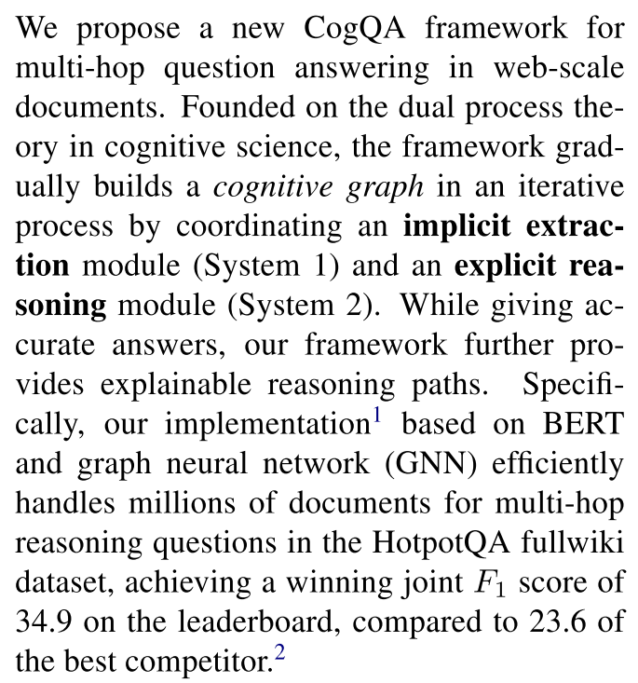
0. Abstract
The authors propose a new CogQA framework for multi-hop QA in web-scale documents.

Slide 3
1. Introduction
Deep learning models have made significant strides in machine reading comprehension and even outperformed human on single paragraph question answering (QA) benchmarks including SQuAD.
However, three main challenges lie ahead:
Explainability
Explicit reasoning paths, which enable verification of logical rigor, are vital for the reliability of QA systems. The HotpotQA requires models to provide supporting sentences.
Scalability
For any practically useful QA system, scalability is indispensable, which means the time consumption of QA will not grow significantly along with the number of paragraphs.
Reasoning Ability
Models for single paragraph QA tend to seek answers in sentences matched by the question, which does not involve complex reasoning.

Slide 4
1. Introduction
Existing QA systems based on machine comprehension generally follow retrieval-extraction framework in DrQA, reducing the scope of sources to a few paragraphs by pre-retrieval.
This framework is a simple compromise between single paragraph QA and scalable information retrieval.

Slide 5
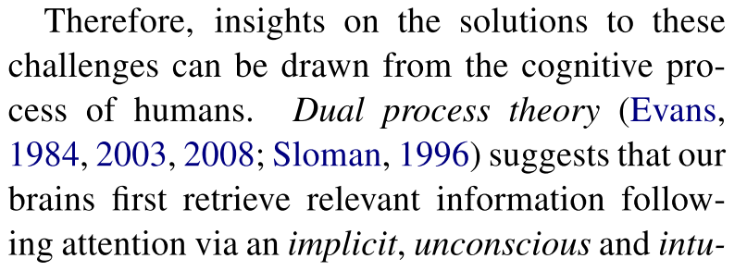
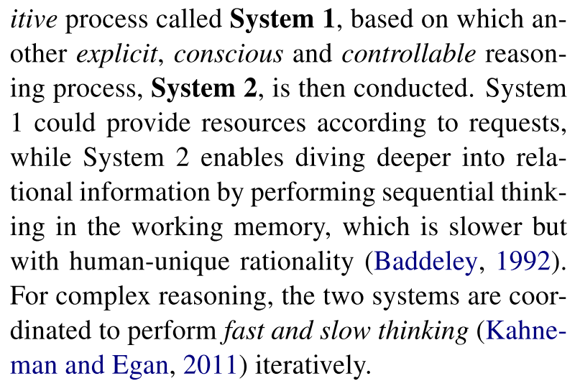
1. Introduction
Therefore, insights on the solutions to these challenges can be drawn from the cognitive process of humans.

Slide 6
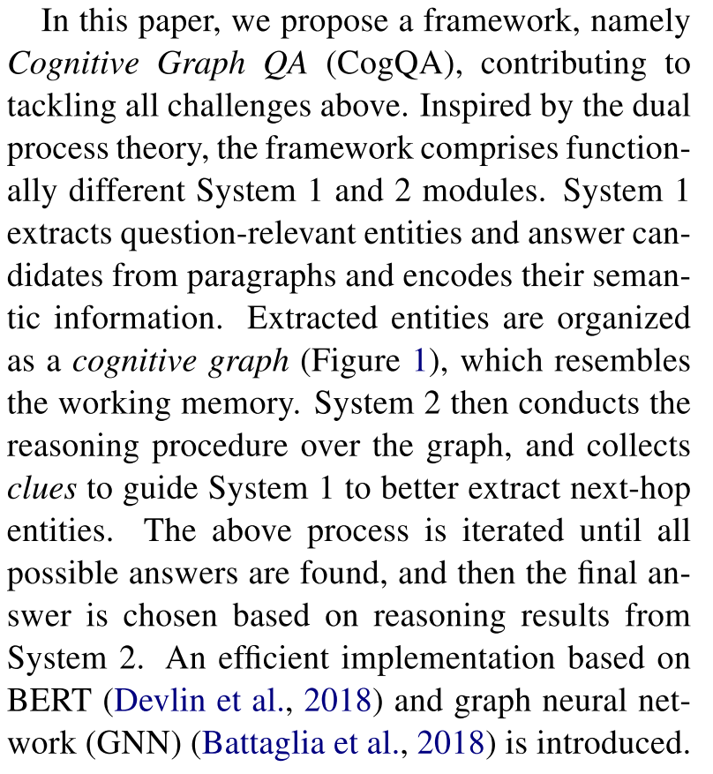
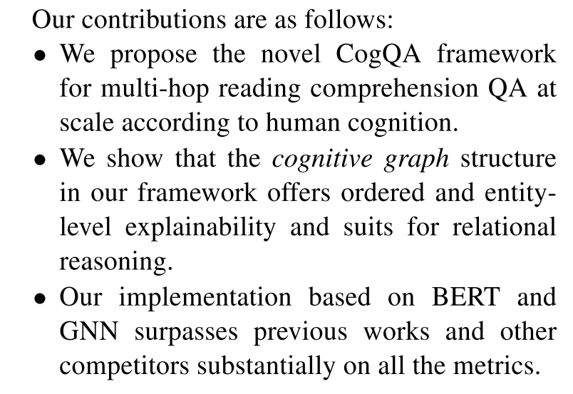
1. Introduction
Introduction of the work:

Slide 7
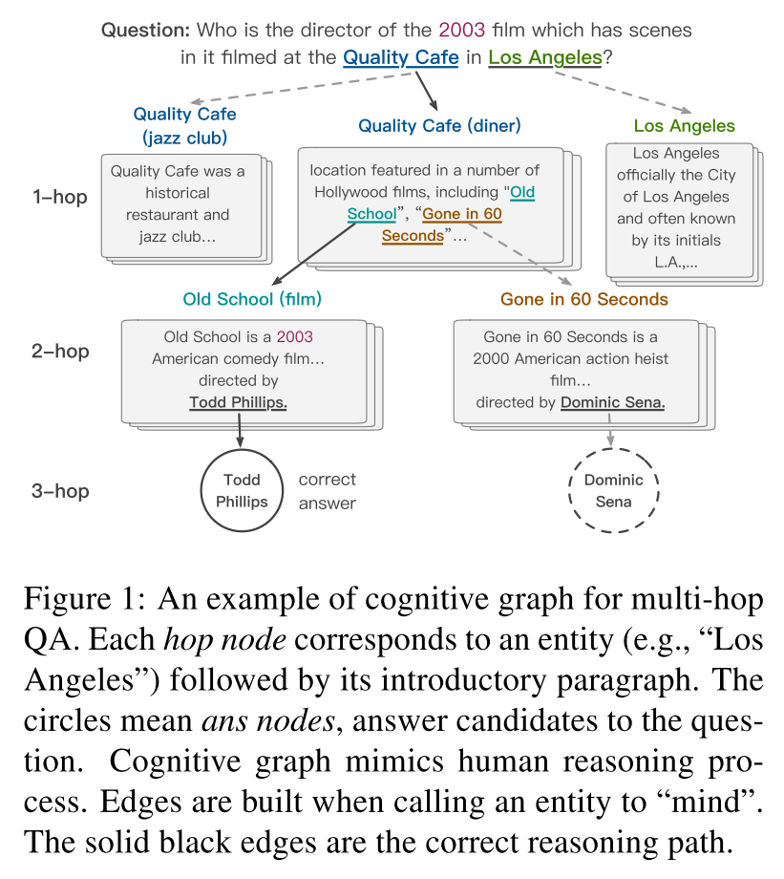
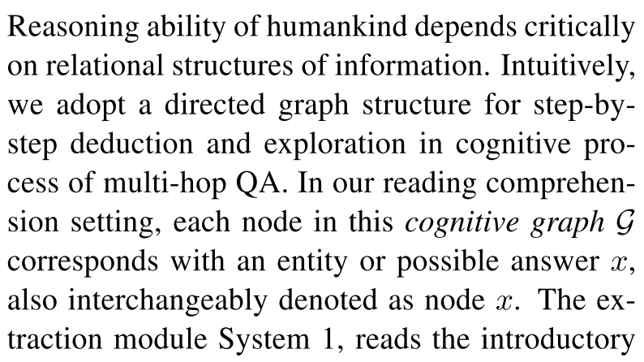
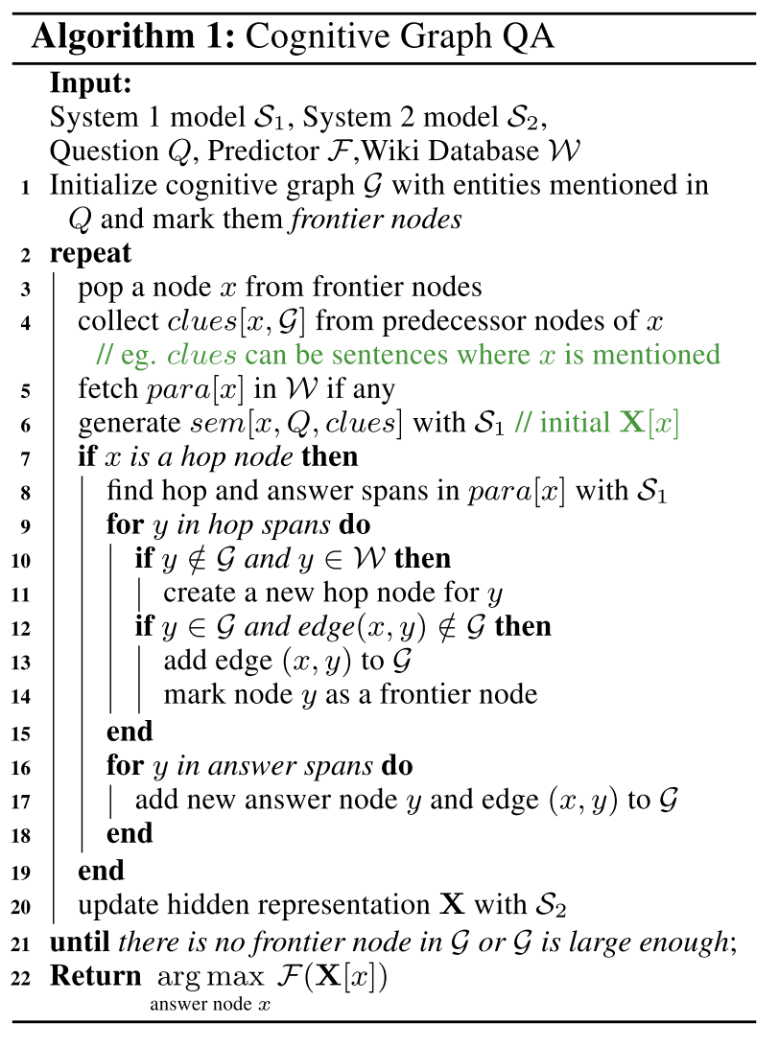
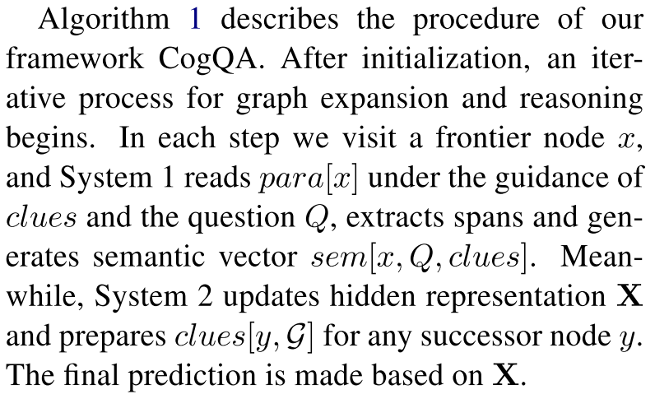
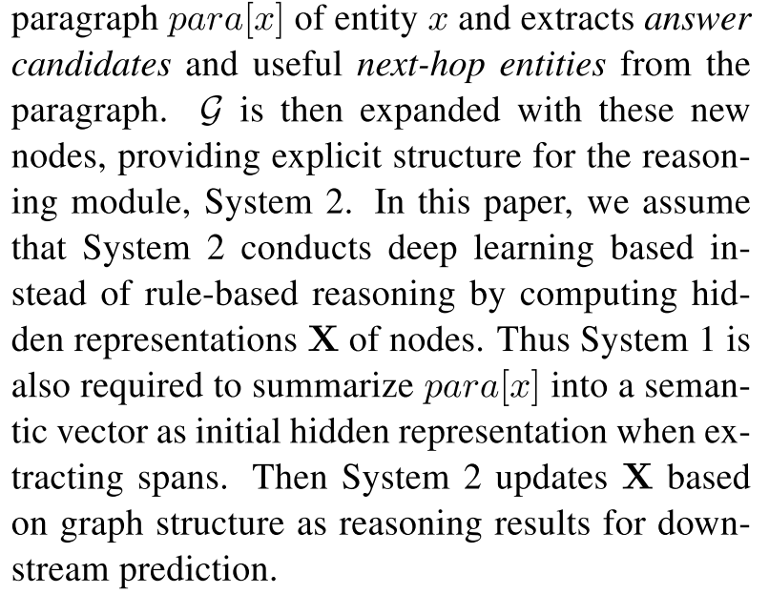
2. Cognitive Graph QA Framework

Slide 8
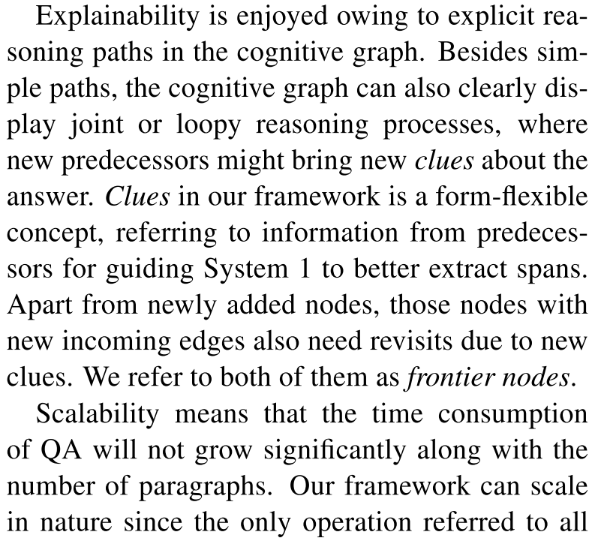
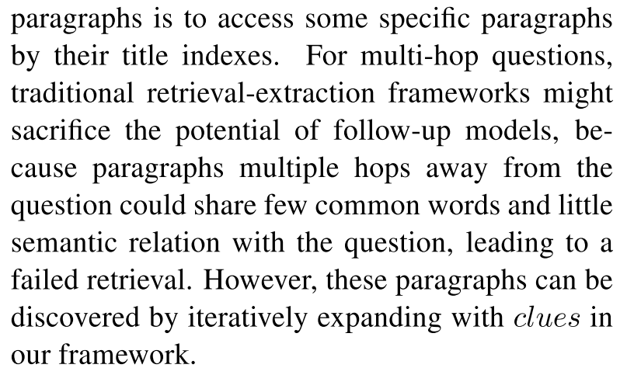
2. Cognitive Graph QA Framework
Advantages: Multi-hop、Explainability、Scalability

Slide 9
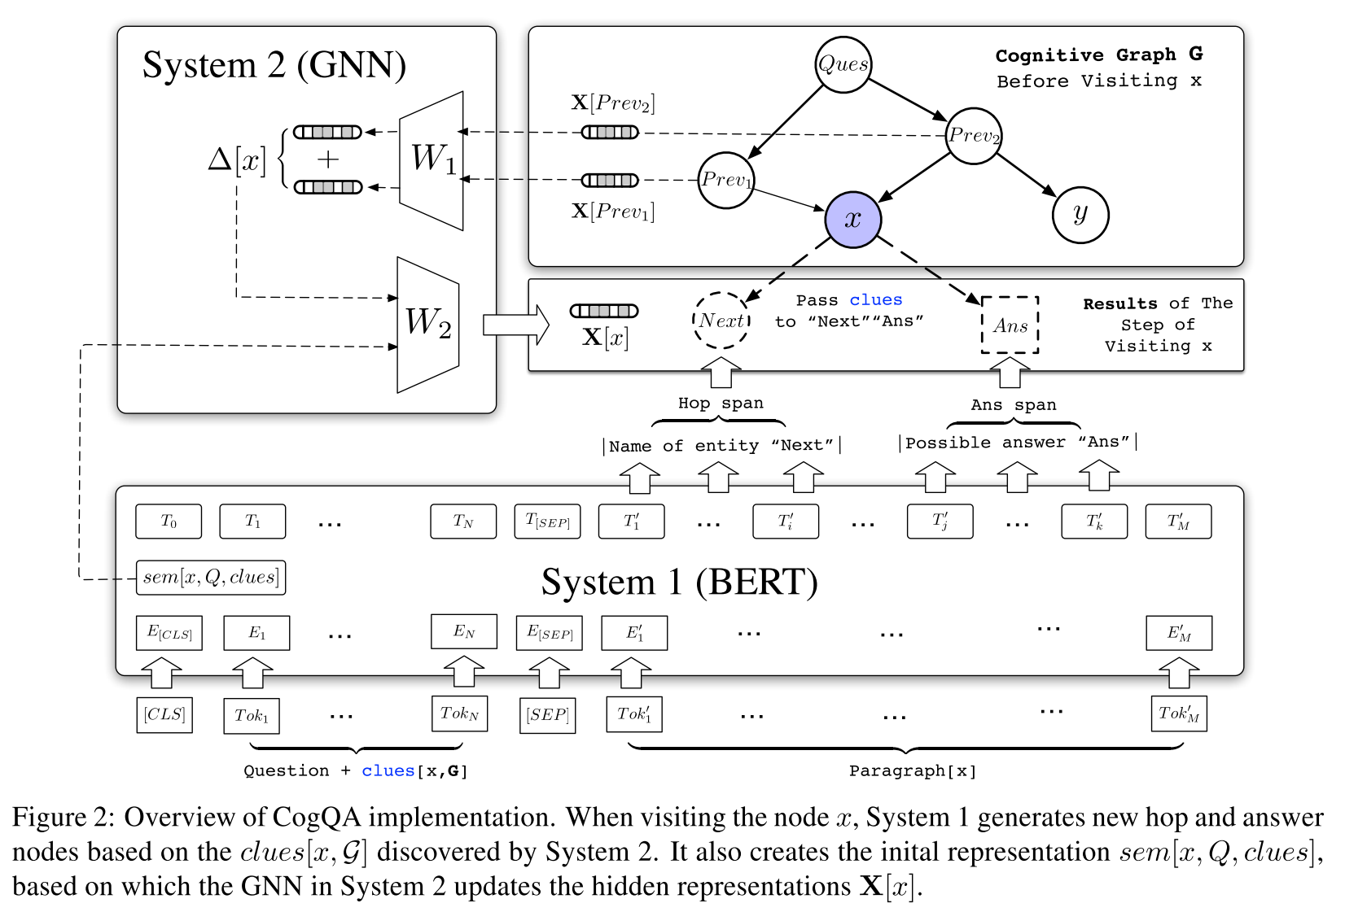
2. Cognitive Graph QA Framework
Overview of CogQA implementation:

Slide 10
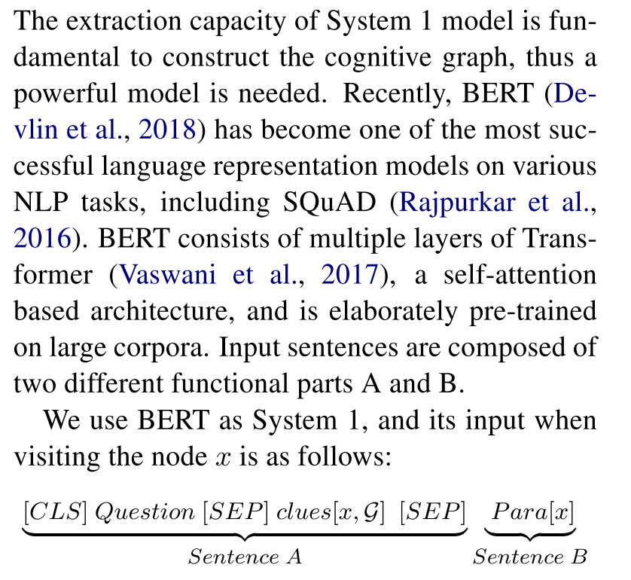
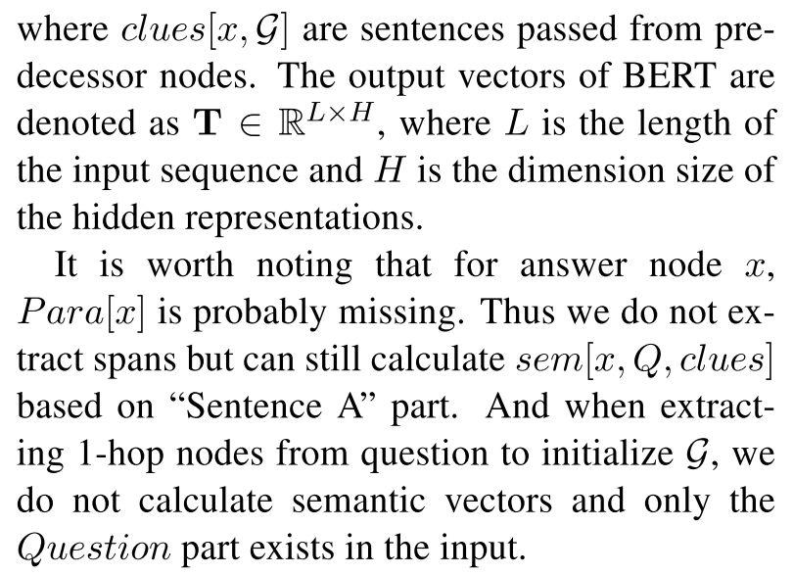
3. Implementation
System1:

Slide 11
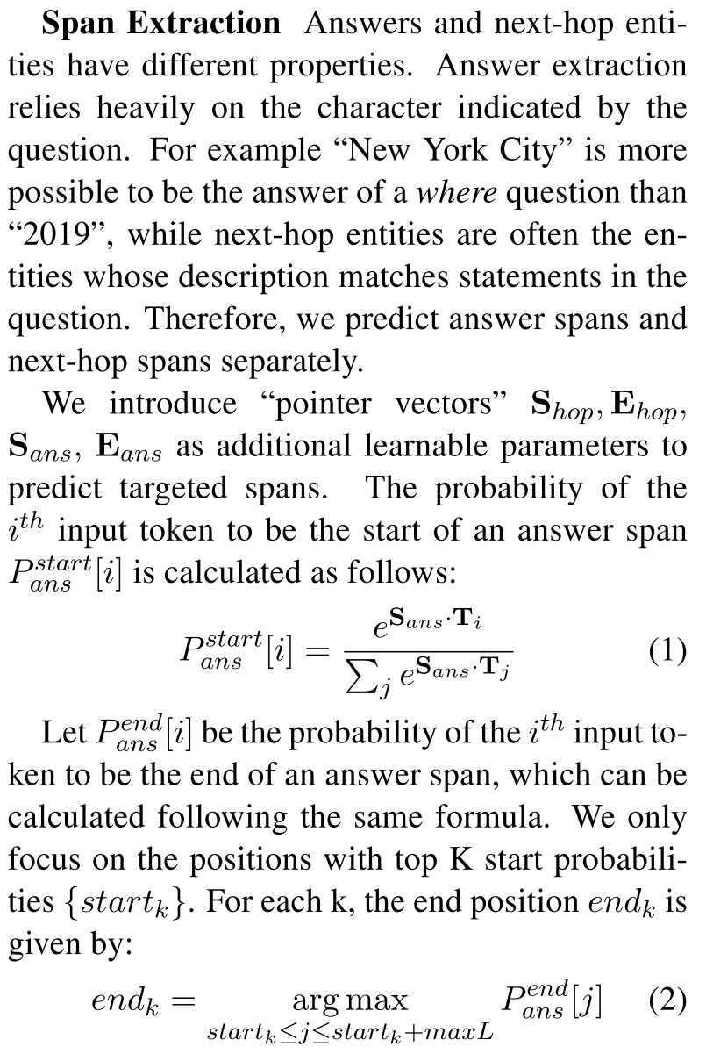
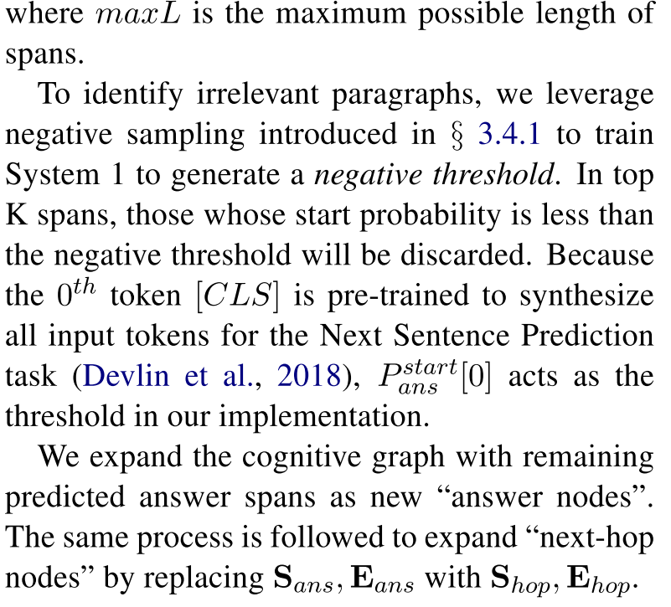
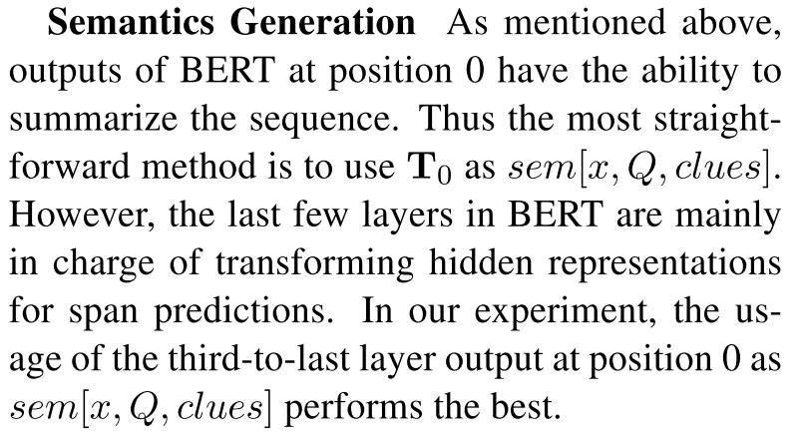
3. Implementation
System1:

Slide 12
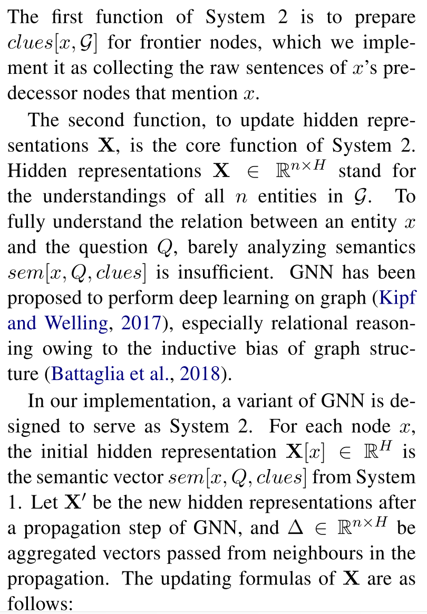
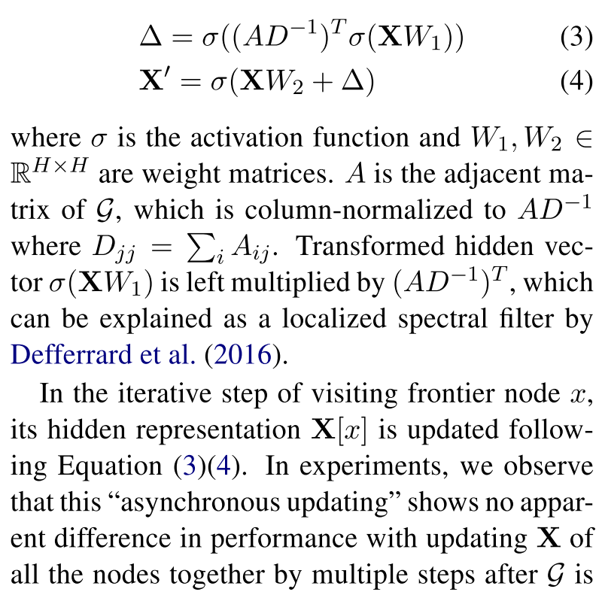
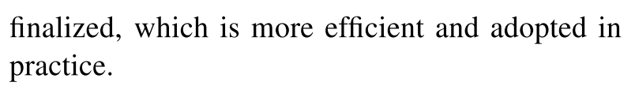
3. Implementation
System2:

Slide 13
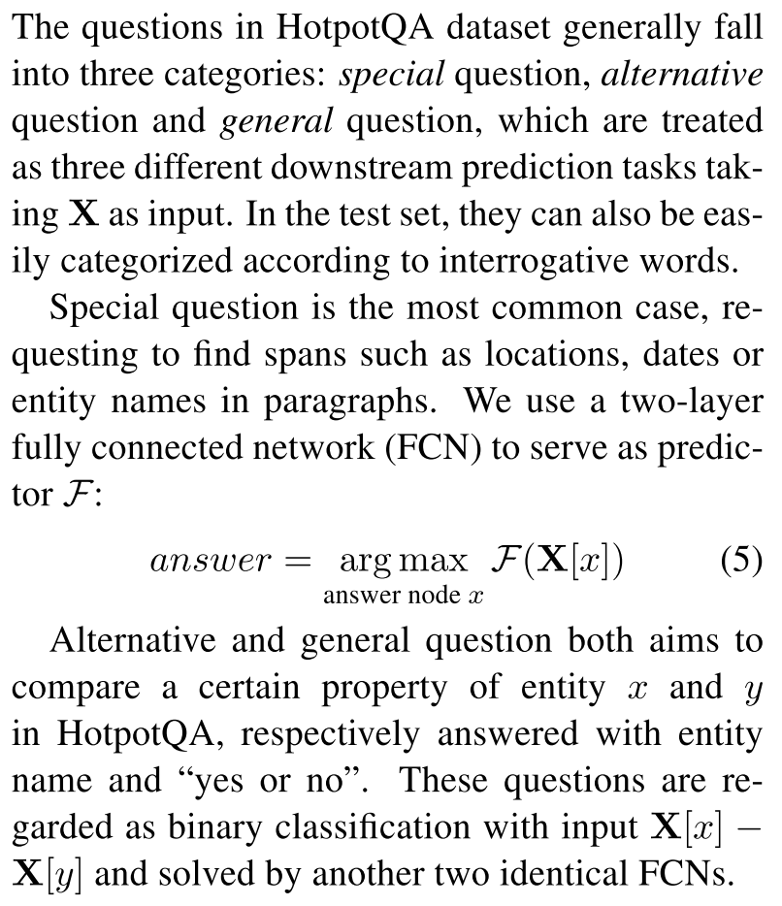
3. Implementation
Predictor:

Slide 14
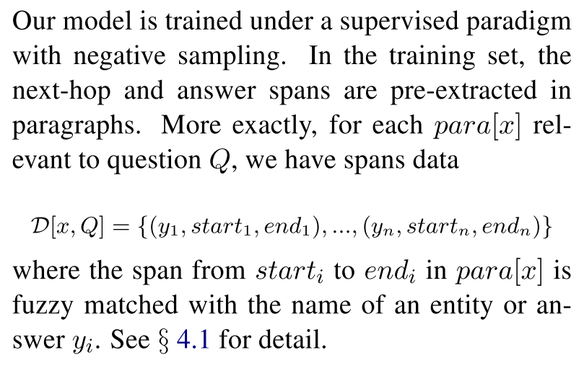
3. Implementation
Training:

Slide 15
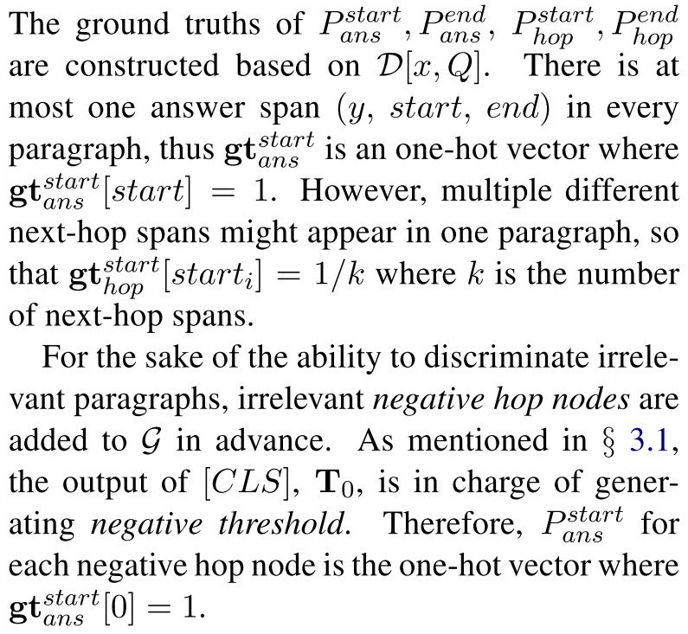
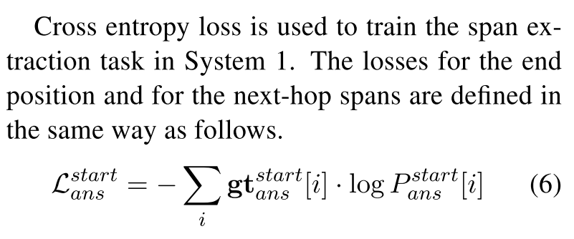
3. Implementation
Tesk1: Span Extraction

Slide 16
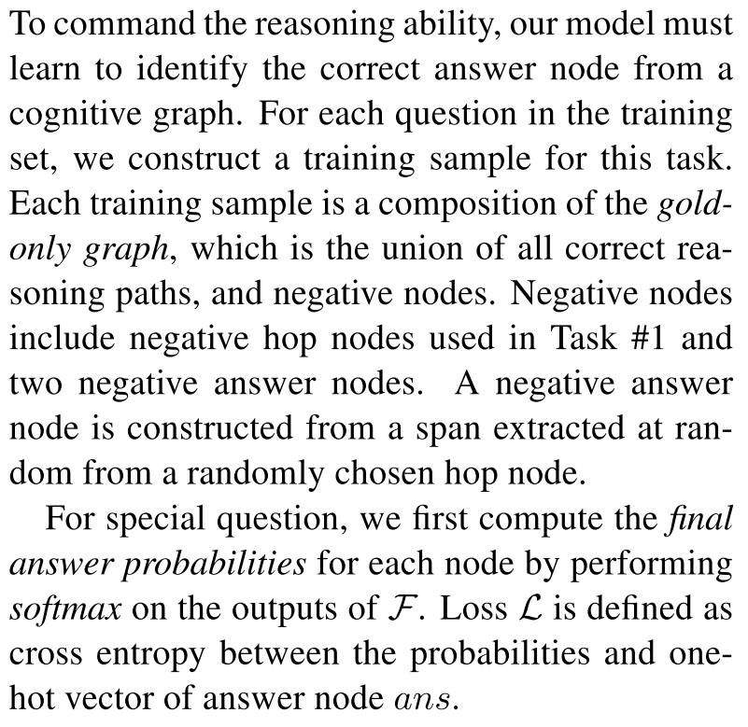
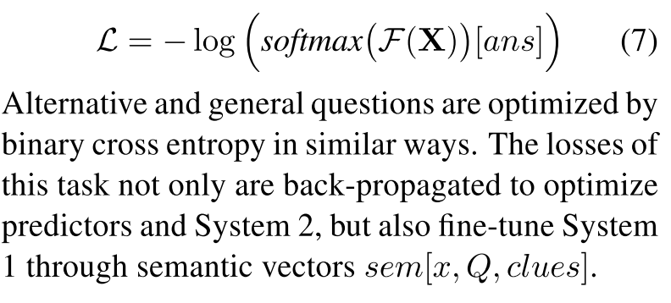
3. Implementation
Tesk2: Answer Node Prediction

Slide 17
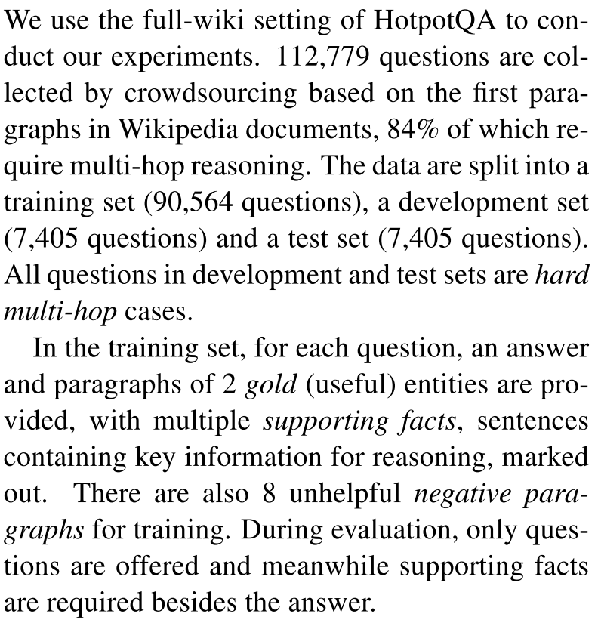
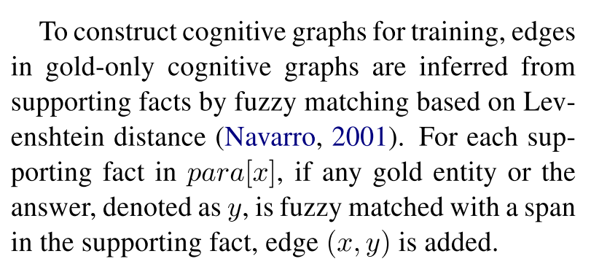
4. Experiment
Dataset:

Slide 18
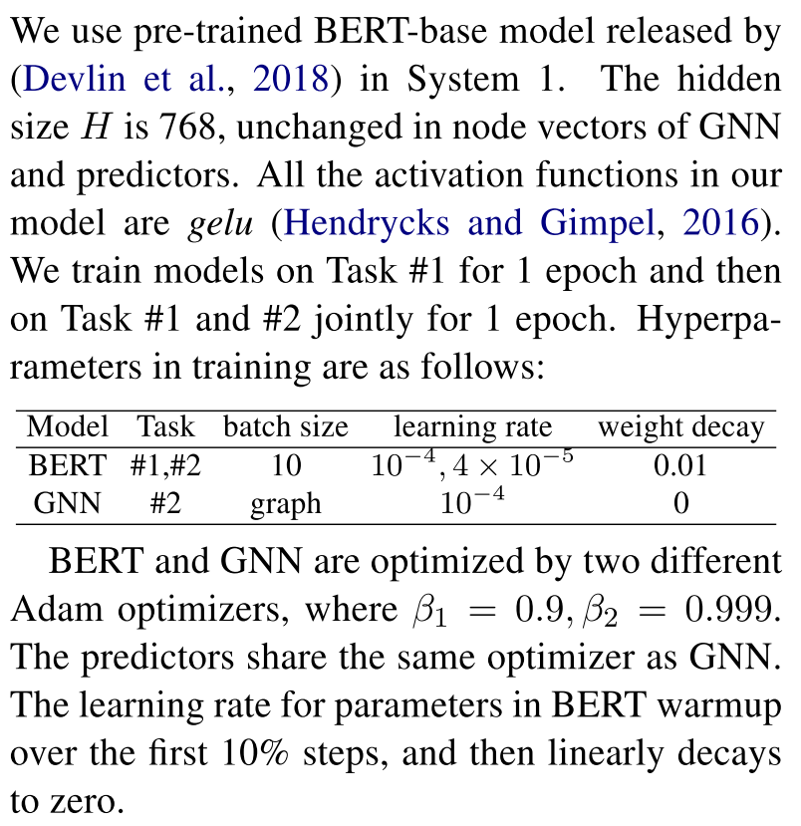
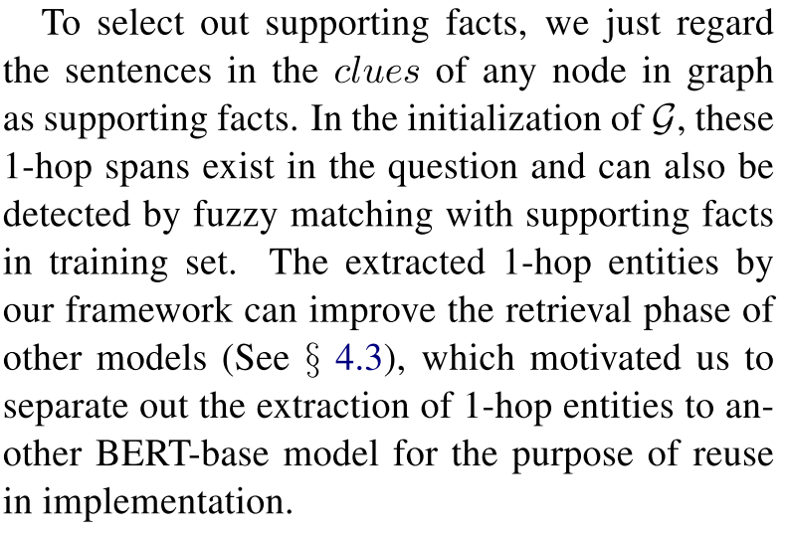
4. Experiment
Experimental Details:

Slide 19
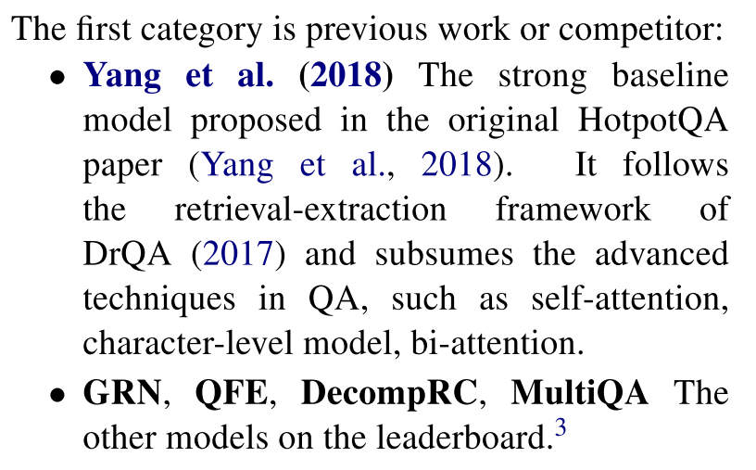
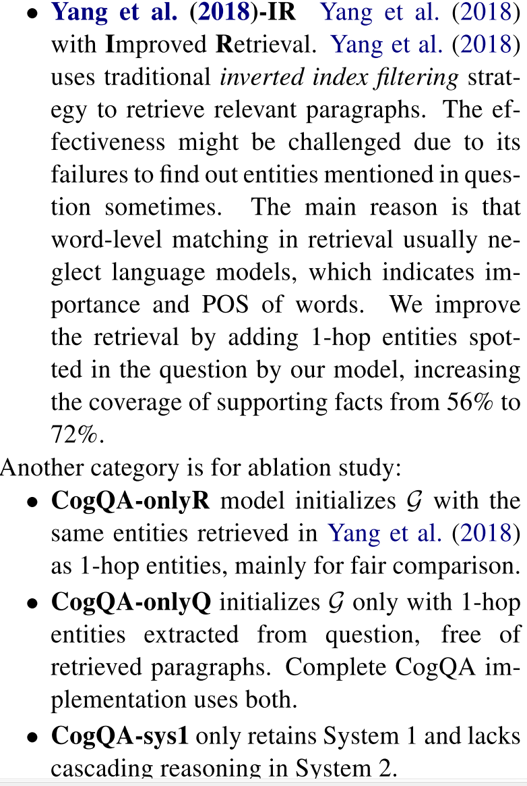
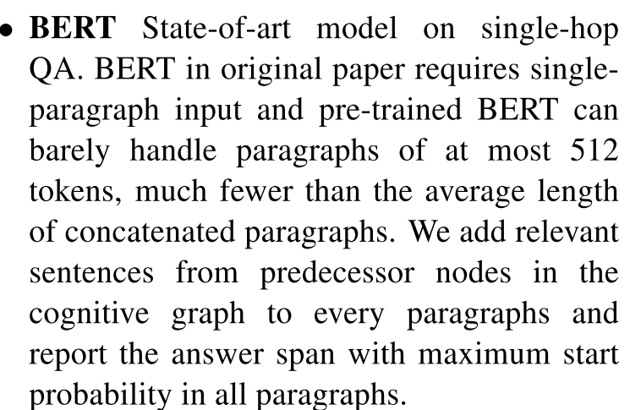
4. Experiment
Baselines:

Slide 20
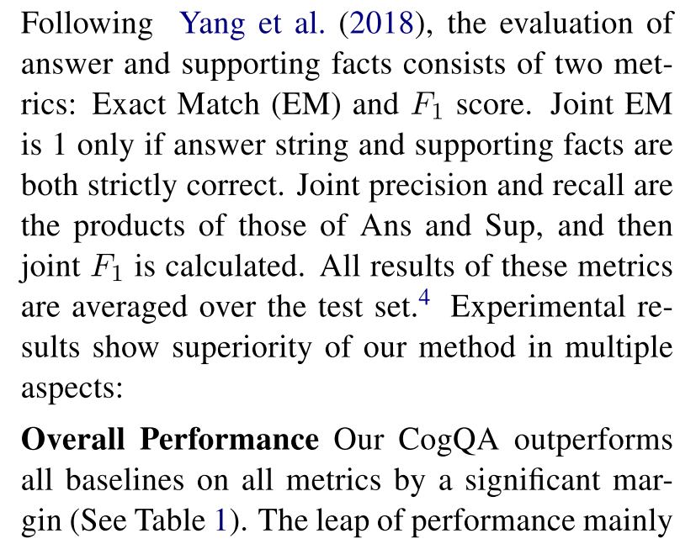
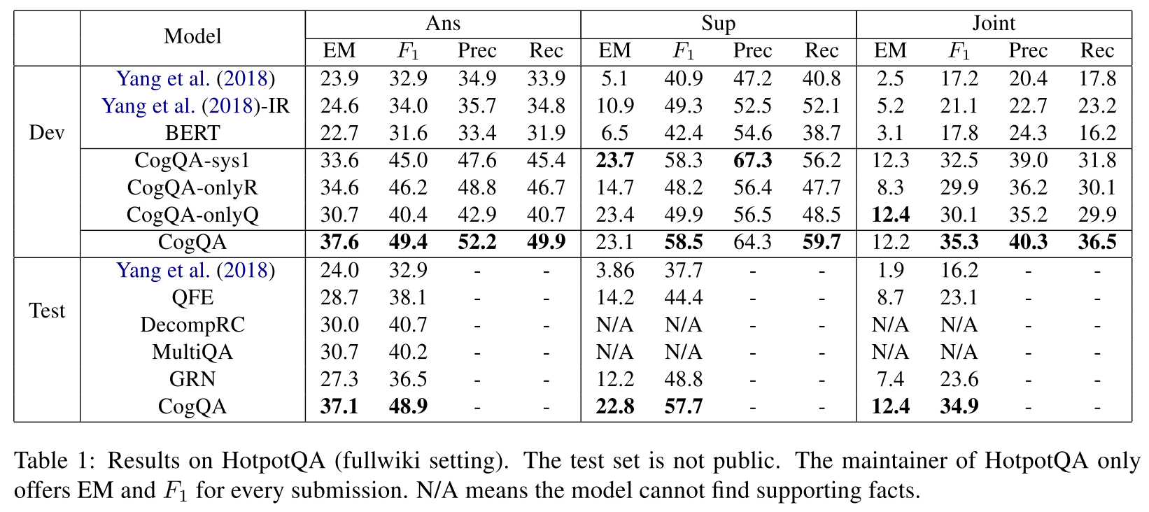
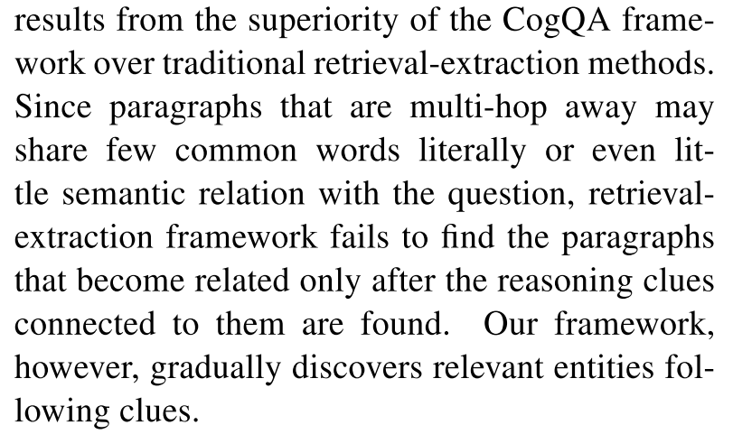
4. Experiment
Results:

Slide 21
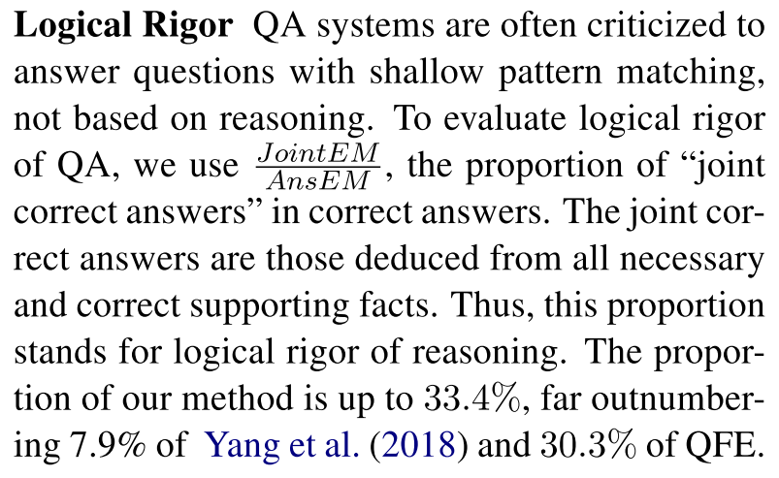
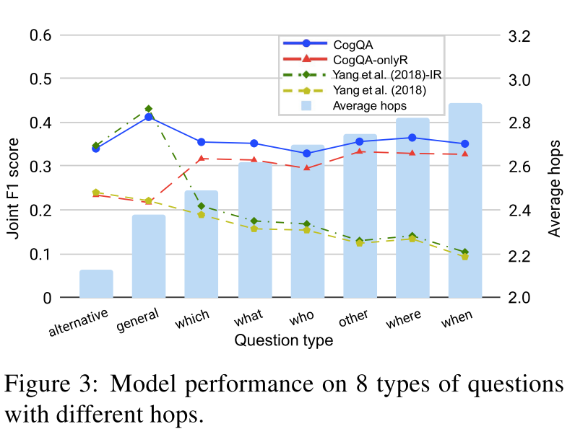
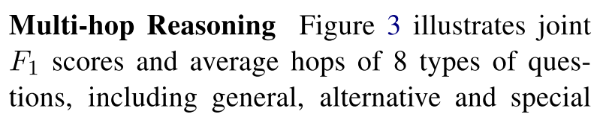
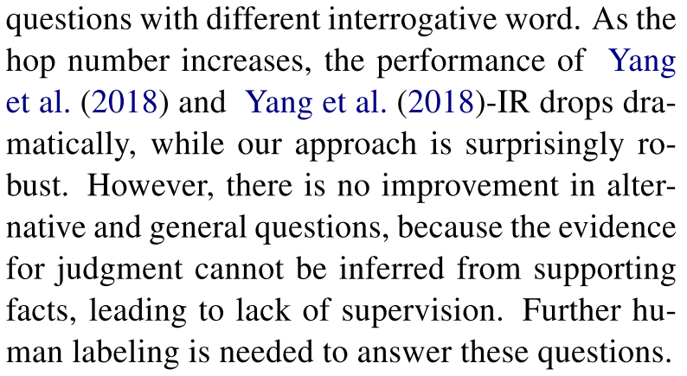
4. Experiment
Results:

Slide 22
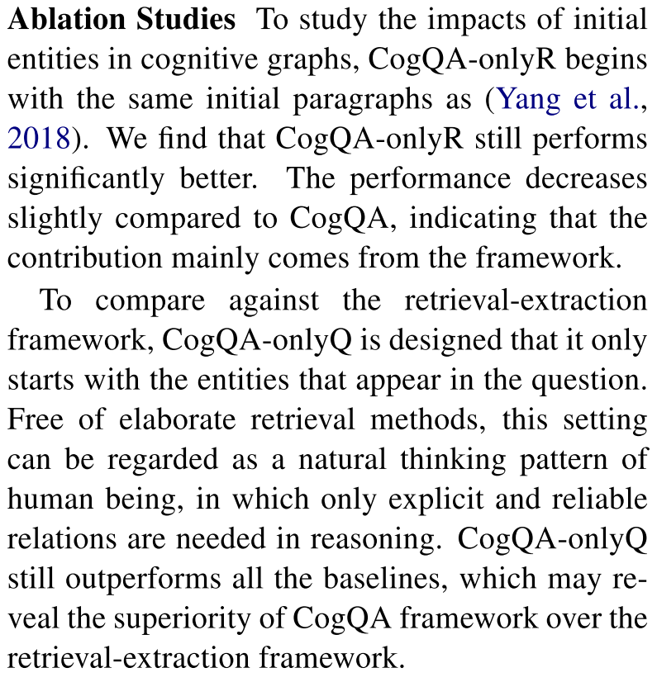
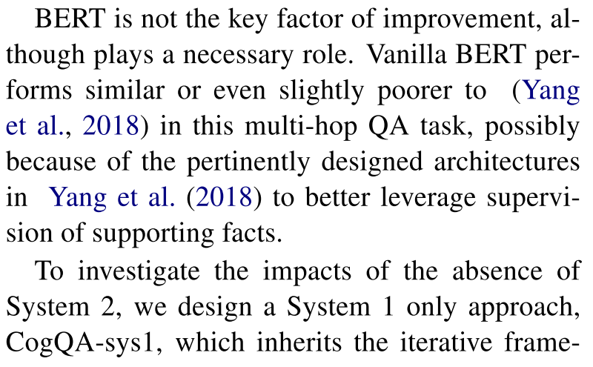
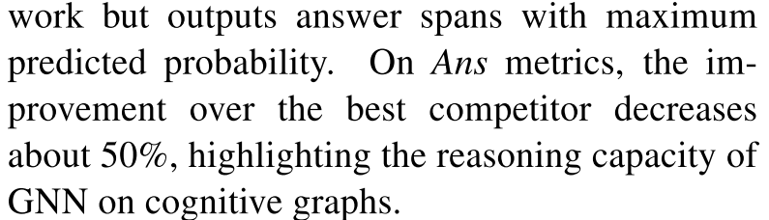
5. Related Work
Ablation Study:

Slide 23
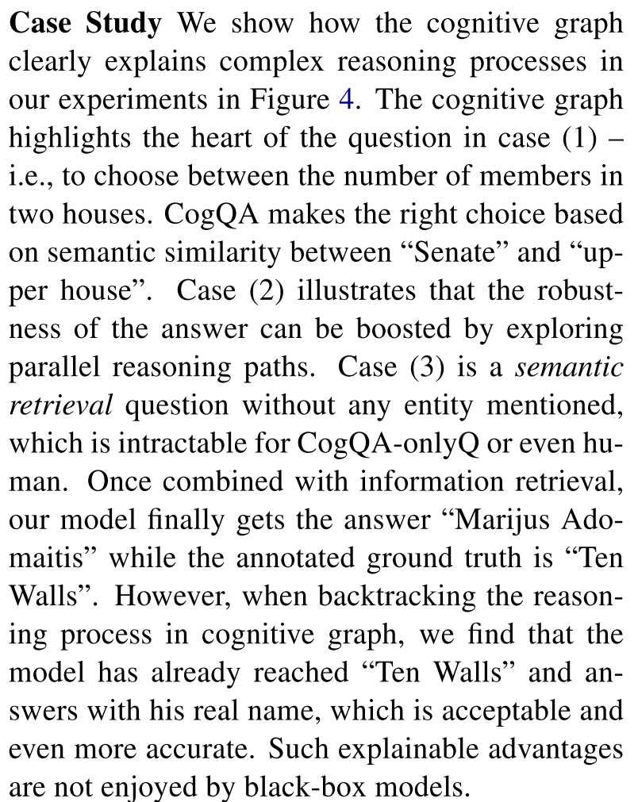
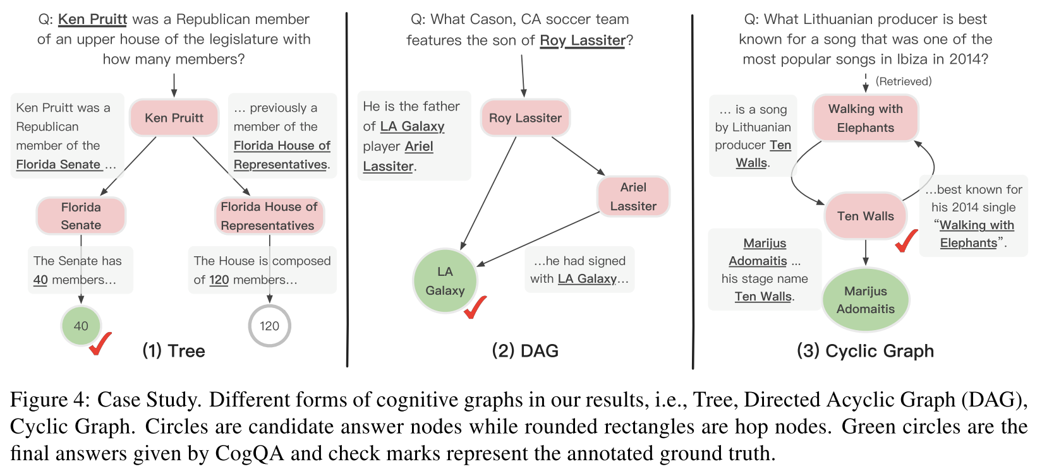
5. Related Work
Case Study:

Slide 24
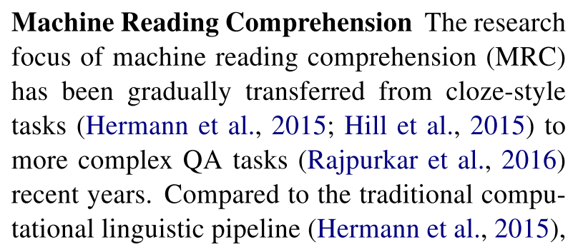
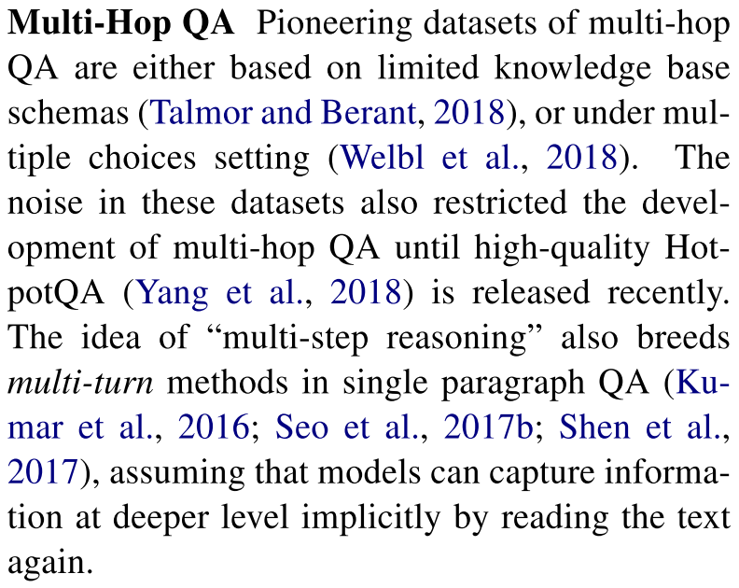
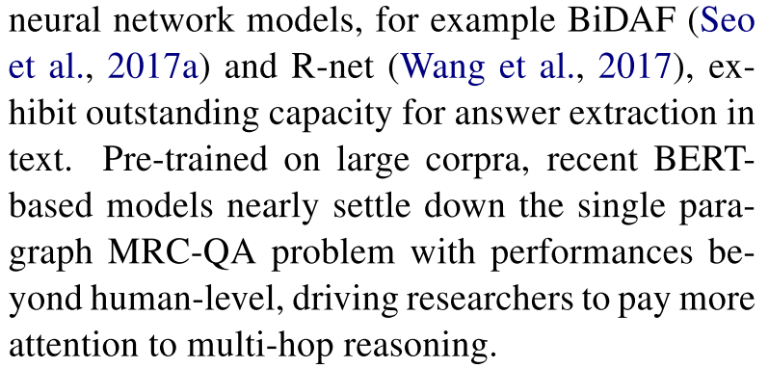
5. Related Work
Related Work:

Slide 25
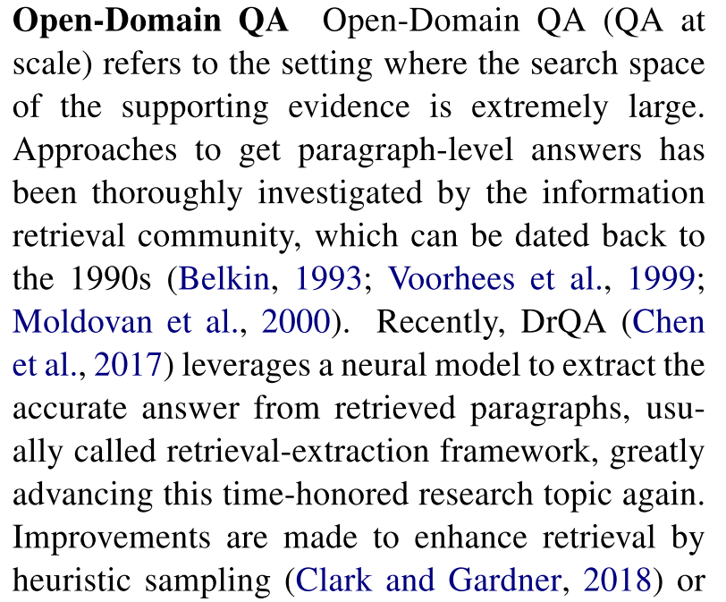

5. Related Work
Related Work:

Slide 26

6. Discussion and Conclusion

Slide 27
4. Conclusion
In this paper, the authors present an end-to-end sequence labeling framework for joint extraction of entities and relations based on a novel decomposition strategy.
Experimental results show that the functional decomposition of the original task simplifies the learning process and leads to a better overall learning outcome, achieving a new state-ofthe-art on three public datasets.
Further analysis demonstrates the ability of our model in handling normal, overlapping and multiple relation extraction.

Slide 28







Hindi
Traditional Chinese
Thai
Thank You
Gracias
Russian
Spanish
Obrigado
English
Danke
Brazilian Portuguese
Arabic
Grazie
German
Italian
Merci
French
Simplified Chinese
Tamil
Korean
Japanese
Notes:
28

